Slide 1
Document or presentation title

Slide 2

Never miss the bus with Azure Function, IFTTT, Azure SQL and GeoSpatial

Slide 3

Document or presentation title
Davide Mauri
Azure SQL PM
#AzConfDev

Slide 4
Davide Mauri
SQL Server / Azure Data MVP for 12 Years
Worked in consulting services for 20 years
Joined Azure SQL group on mid 2019
Still a developer at heart!
Now Azure SQL PM
Focus on Azure SQL Hyperscale & Developers
Very active in the Community, Conference Speaker
Website: http://davidemauri.it/
DevBlogs: https://devblogs.microsoft.com/azure-sql/
Dev.To: https://dev.to/yorek

Slide 5

Practical Azure SQL Database for Modern Developers
A developer-focused book, to help you leverage all the relational and post-relational features that Azure SQL has, to easily create fast, scalable and secure applications
Lots of samples and discussions taking into account different languages:
Python
.NET
Java
And more!

Slide 6

Sponsors
DevOps Partner
#AzConfDev

Slide 7

Communities
#AzConfDev

Slide 8

Communities
#AzConfDev

Slide 9
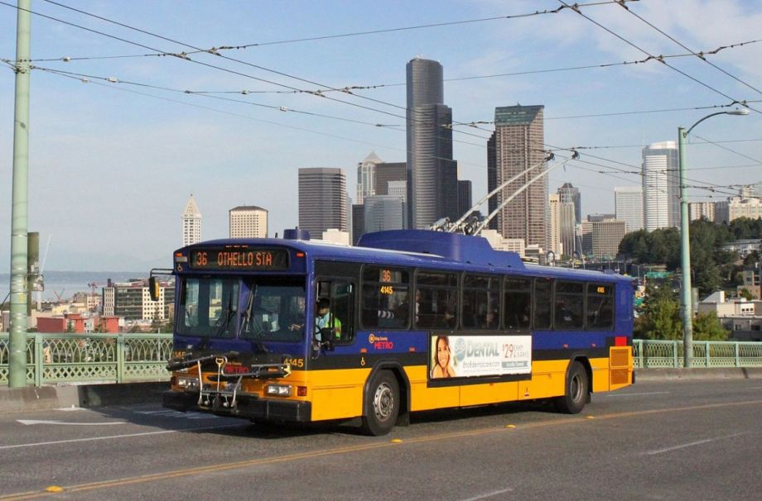
Never Miss The Bus!
A real life challenge!
When I should get out of the office to make sure I can catch the bus to go back home in time?
Schedule and forecasts are not accurate due to wild traffic
I wish I could have real time bus location…

Slide 10
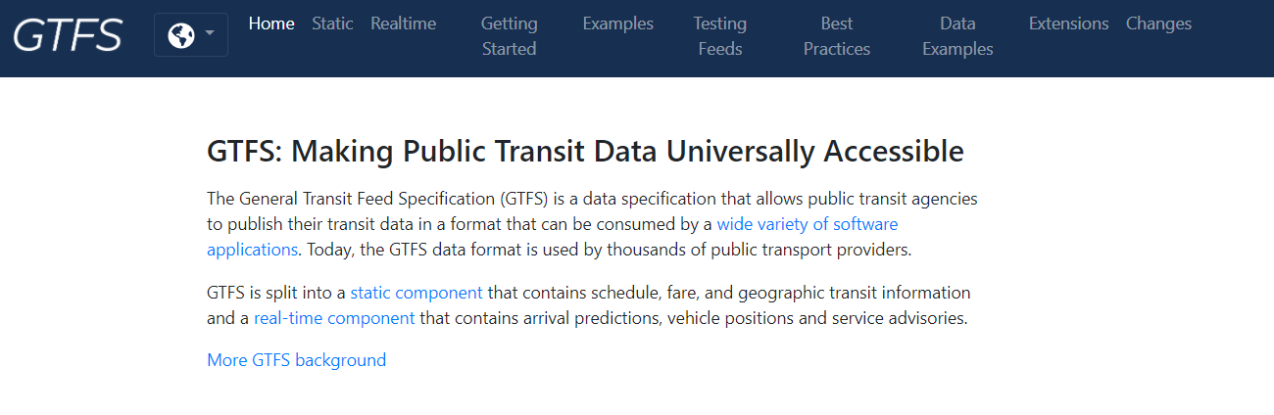
Never Miss The Bus!
It turns out that there is a global initiative to make public transit data universally accessible: https://gtfs.org/

Slide 11

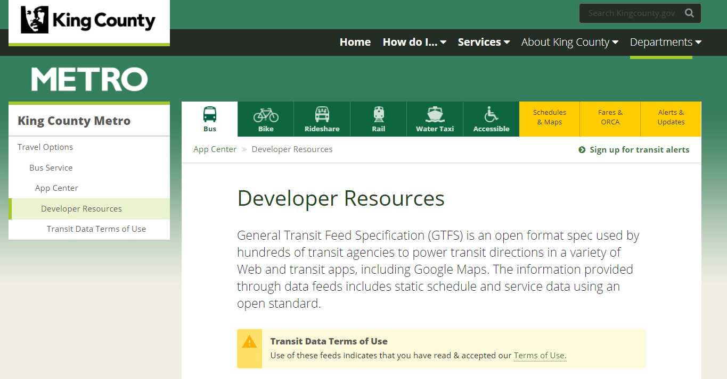
Never Miss The Bus!
King County Metro supports that!

Slide 12
Never Miss The Bus!
Problem solved in 8 steps:
Get the RealTime FTS Feed
Filter only routes I’m interested in
Store data somewhere
Create a geofence
Check if the bus is entering or leaving the geofence
If yes, send a notification to my phone
Leave the office
Catch the bus

Slide 13


Never Miss The Bus!
Geofencing and Geospatial locations can be a little complex to manage
Azure SQL get us covered!

Slide 14
Never Miss The Bus!
Geospatial Support in Azure SQL
OGC Standard
Azure SQL / SQL Server specific extensions
Data Types
Geometry
Geography
Additional Features
Indexing
https://github.com/Azure-Samples/azure-sql-db-serverless-geospatial

Slide 15
Demo!
#AzConfDev

Slide 16
Thank You!
#AzConfDev

Slide 17
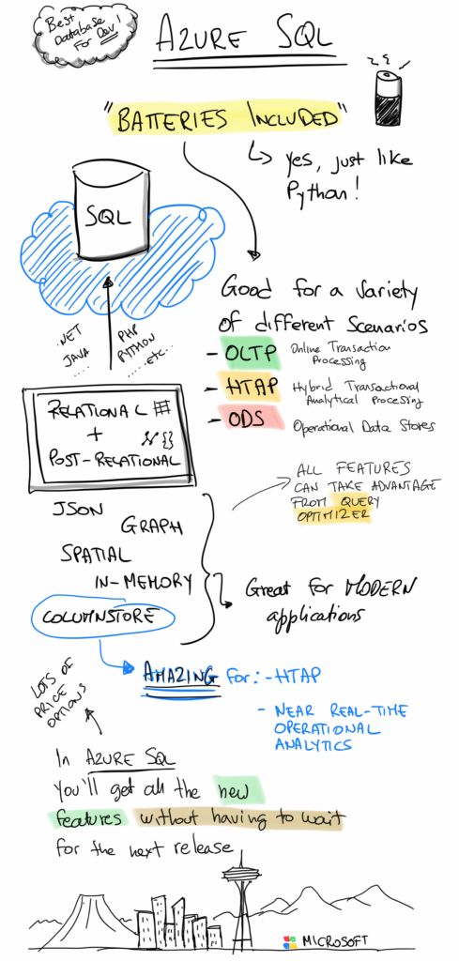
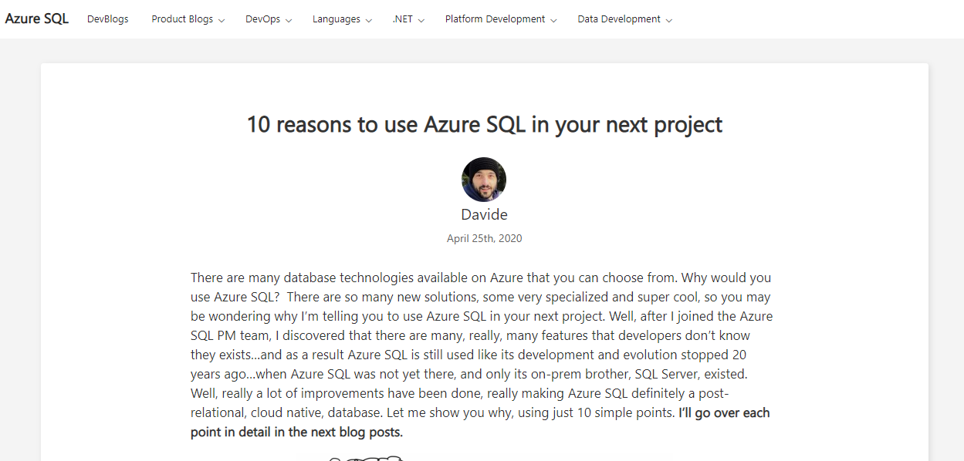
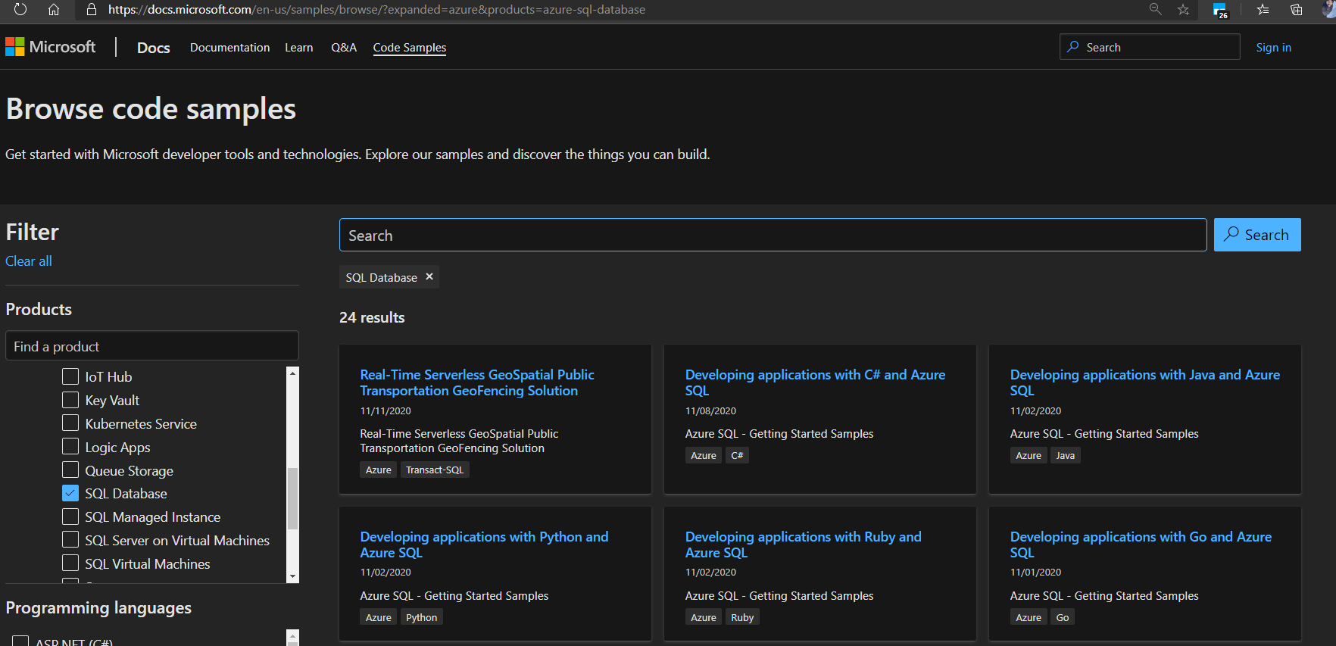
https://devblogs.microsoft.com/azure-sql/
https://docs.microsoft.com/en-us/samples

